Slide 1

Computer Programming for Engineers
Week 3 Lecture 1
Sep. 13, 2022
Lecturer: Mohammad Mahdi Javidan
College of Engineering, Sungkyunkwan University
Fall Semester 2022

Slide 2
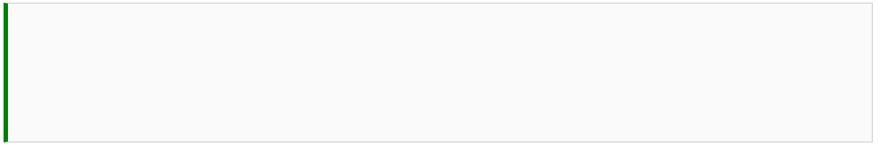





Function Basics
Checking a built-in function
To see how to use a function
help()
College of Engineering, Sungkyunkwan University

Slide 3
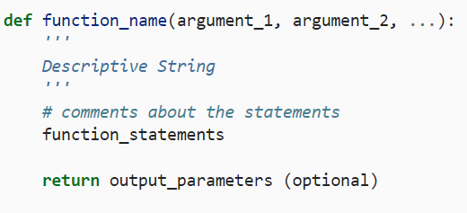
Function Basics
Checking a built-in function
Input argument
Header
Can be seen using help()
Body
College of Engineering, Sungkyunkwan University

Slide 4
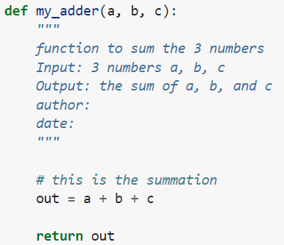
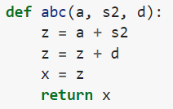
Function Basics
A function that receives three numbers and returns the sum
Poor representation of the same function
College of Engineering, Sungkyunkwan University

Slide 5



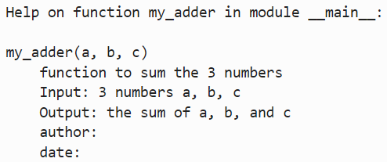

Function Basics
How to use the defined function
Error!
College of Engineering, Sungkyunkwan University

Slide 6
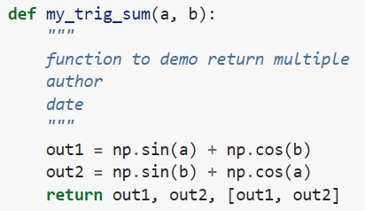


Function Basics
Functions with several outputs
Assigning the output to several variables
Assigning the output to one variable
College of Engineering, Sungkyunkwan University

Slide 7
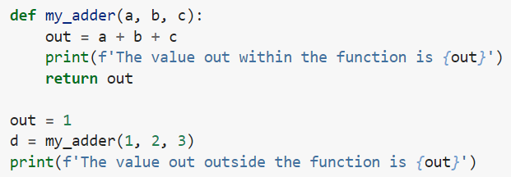

Local and Global Variables
College of Engineering, Sungkyunkwan University

Slide 8
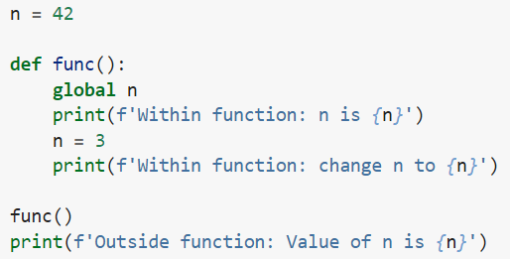

Local and Global Variables
The keyword global
College of Engineering, Sungkyunkwan University

Slide 9
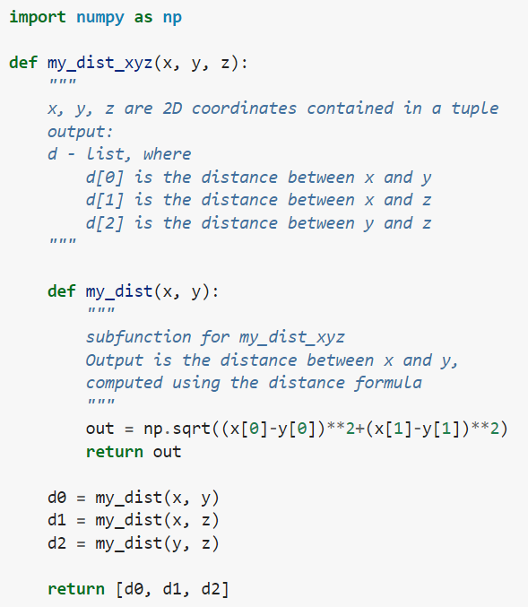
Nested Functions
Parent function
Nested function
College of Engineering, Sungkyunkwan University

Slide 10


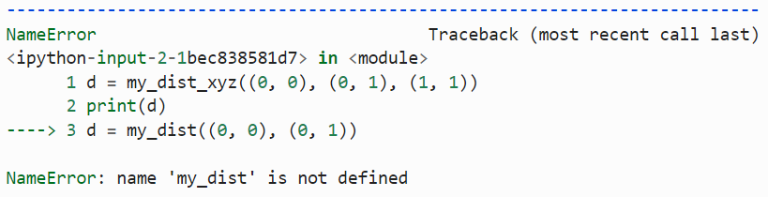
Nested Functions
College of Engineering, Sungkyunkwan University

Slide 11
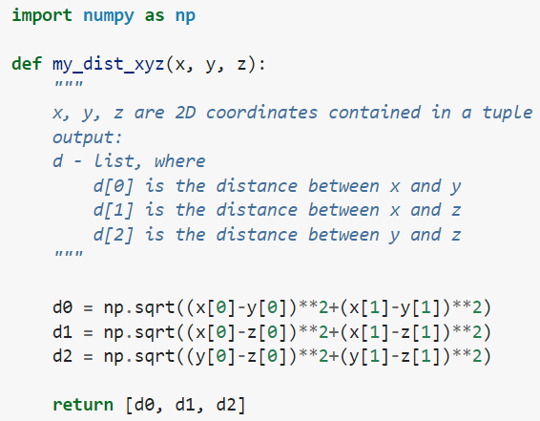
Nested Functions
The same function without using a nested function
College of Engineering, Sungkyunkwan University

Slide 12


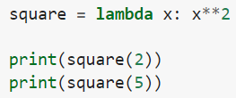


Lambda Functions
A condensed way of defining a function
Lambda function with several arguments
College of Engineering, Sungkyunkwan University

Slide 13


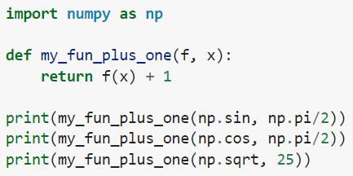

Functions as Arguments
Assigning a function to a variable
Passing a function as an argument
Answer ?
College of Engineering, Sungkyunkwan University

Slide 14

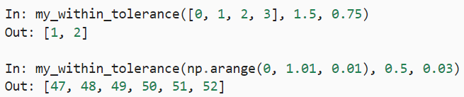
Assignment 3
Let r1 and r2 be the radius of circles with the same center and let r2>r1. Write a function my_donut_area(r1, r2), where the output is the area outside of the circle with radius r1 and inside the circle with radius r2. Make sure that the function is vectorized. Assume that r1 and r2 are one-dimensional array of the same size.
Test Case
Write a function my_within_tolerance(A,a,tol), where the output is an array or list of the indices in A such that |A−a|<tol. Assume that A is a one-dimensional float list or array and that a and tol are 1 by 1 floats.
Test Case
College of Engineering, Sungkyunkwan University

Slide 15




Assignment 3
Write a function my_tip_calc(bill, party), where bill is the total cost of a meal and party is the number of people in the group. The tip should be calculated as 15% for a party strictly less than six people, 18% for a party strictly less than eight, 20% for a party less than 11, and 25% for a party 11 or more. A couple of test cases are given below.
Test Case
College of Engineering, Sungkyunkwan University

Slide 16



Assignment 3
Consider a triangle with vertices at (0,0), (1,0), and (0,1). Write a function my_inside_triangle(x,y) where the output is the string ‘outside’ if the point (x,y) is outside of the triangle, ‘border’ if the point is exactly on the border of the triangle, and ‘inside’ if the point is on the inside of the triangle.
Test Case
College of Engineering, Sungkyunkwan University

Slide 17



Assignment 3
The interest, i, on a principle, P0, is a payment for allowing the bank to use your money. Compound interest is accumulated according to the formula Pn=(1+i)Pn−1, where n is the compounding period, usually in months or years. Write a function my_saving_plan(P0, i, goal) where the output is the number of years it will take P0 to become goal at i% interest compounded annually.
Test Case
College of Engineering, Sungkyunkwan University

Slide 18
Assignment 3
A number is prime if it is divisible without remainder only by itself and 1. The number 1 is not prime. Write a function my_is_prime(n), where output is 1 if n is prime and 0 otherwise. Assume that n is a strictly positive integer.
College of Engineering, Sungkyunkwan University

